Slide 1

Human Machine Interaction
Experiment 2: To design a system based on user-centered approach

Slide 2
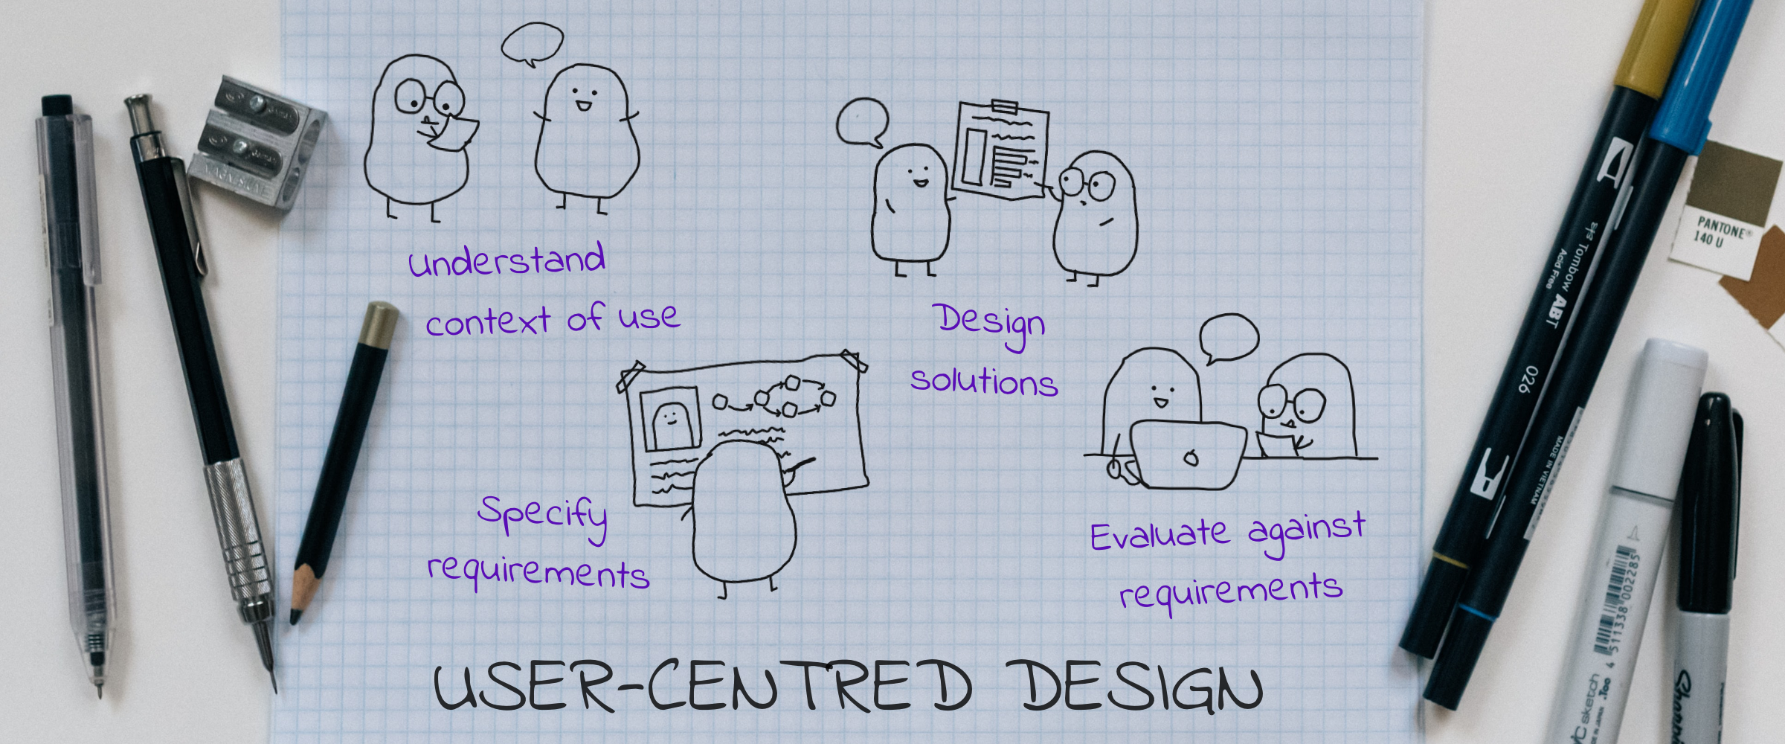
Following are the activities involved in design process :
Understanding user requirements.
Understanding purpose of the user.
Understanding the work environments.
Computer System Design is the process that consists of a user-oriented approach where all meaningful activities are systematically framed together and utmost importance is given to the person who is going to use that system.

Slide 3

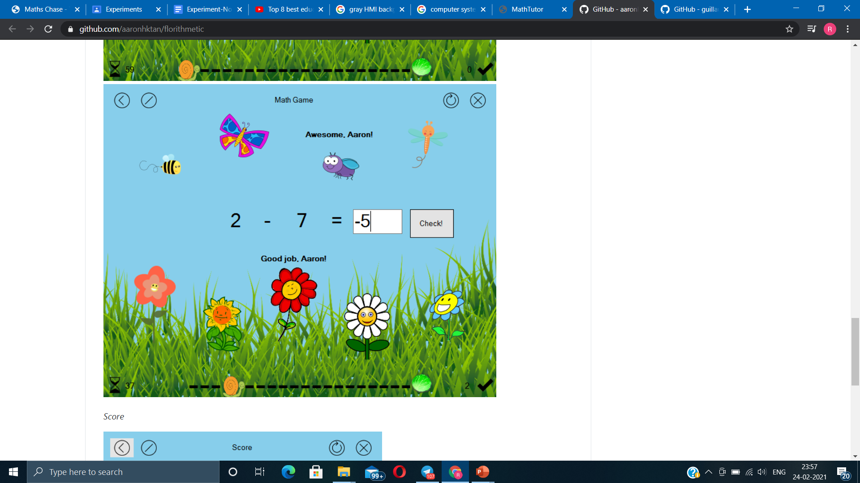

An application to teach math to Perform analysis of children behavior e.g. their preferences, interests etc.
Math Tutor (Our Application)
Math Game (Random Application)
Good Job. You Answered correctly!
A simple math game for kids, with animation, music, and scoring written in Visual Basic.

Slide 4
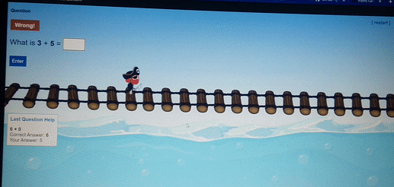
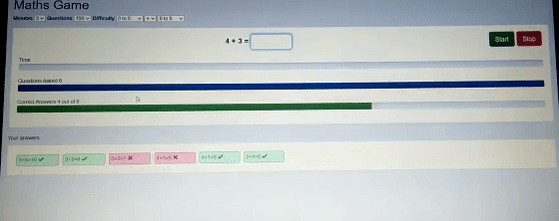
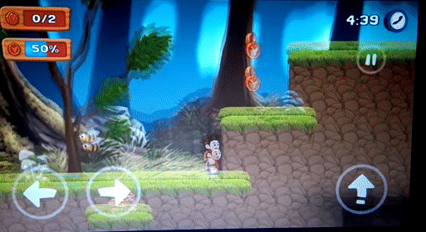
Comparison of some existing applications in the market
Application 2
Application 3
Application 1

Slide 5
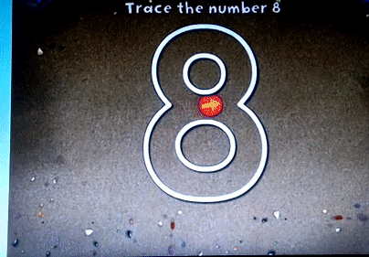
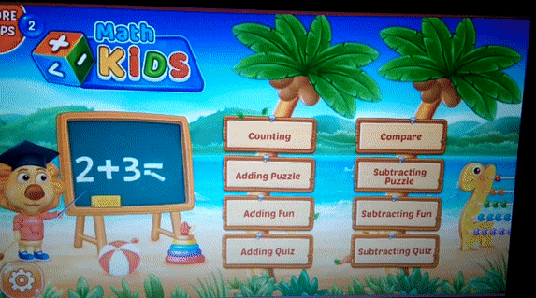
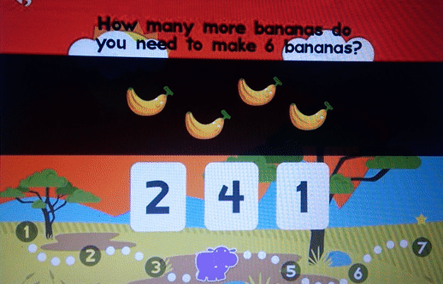
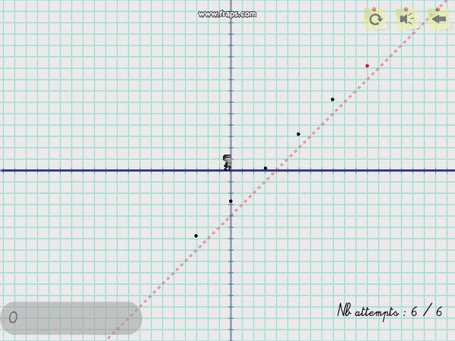
Some existing applications in the market
An Advanced level maths application, The goal was to make a platform game using Maths curves as the main gameplay element.

